Slide 1
GRAPHICAL PASSWORD AUTHENTICATION SYSTEM
WEB DEVELOPMENT CAPSTONE PROJECT
Presented By:
1. MAMMULA ARCHANA (S170178)
2. VANGAPANDU SAI SIREESHA (S170134)
3. SADHANALA DEVI NAGARJINI (S170188)
Guided By: UMA MAHESHWARI MADAM

Slide 2
OUTLINE
Abstract
Problem Statement (Should not include solution)
Aims , Objective & Proposed System/Solution
System Design
System Development Approach(Technology Used)
Algorithm & Deployment
Conclusion
References
Future Scope

Slide 3
Abstract
A Graphical Password is an Authentication System that works by having the user select from images, in a specific order, presented in a Graphical User Interface (GUI). For this reason, the graphical-password approach is called Graphical User Authentication (GUA). The most common computer authentication method is to use alphanumerical usernames and passwords. This method has been shown to have significant disadvantages. For E.g. Users tend to choose passwords that can be easily guessed. On the other hand, if a password is difficult to guess, then it is often difficult to remember. To overcome this problem of low security, Authentication methods are developed by researchers that use images as password. In this research paper, we conduct a comprehensive survey of the existing graphical password techniques and provide a possible theory of our own. Graphical password schemes have been proposed as a possible alternative to text-based schemes, by the fact that humans can remember pictures better than text; Pictures are generally easier to be remembered or recognized than text.

Slide 4
Problem Statement
The main problem of alphanumeric passwords are very hard to remember and less secure. So, we thought that the passwords are high secure and easy to remember so, we create the graphical passwords to easy to remember and high secure. By using the alphanumeric passwords very hard to remember and less secure. Graphical Password Authentication System is a way of creating the passwords without using letters, numbers, symbols in a keyboard.

Slide 5
Proposed Solution
Graphical passwords were first introduced by BLONDER in 1996. A graphical password is an authentication system which allows the users to select from images, in a specific order, presented in a graphical user interface (GUI). Graphical passwords can be easily remembered, as users remember images better than words. Graphical passwords techniques are categorized into two main techniques: recall-based and recognition-based graphical techniques.

Slide 6
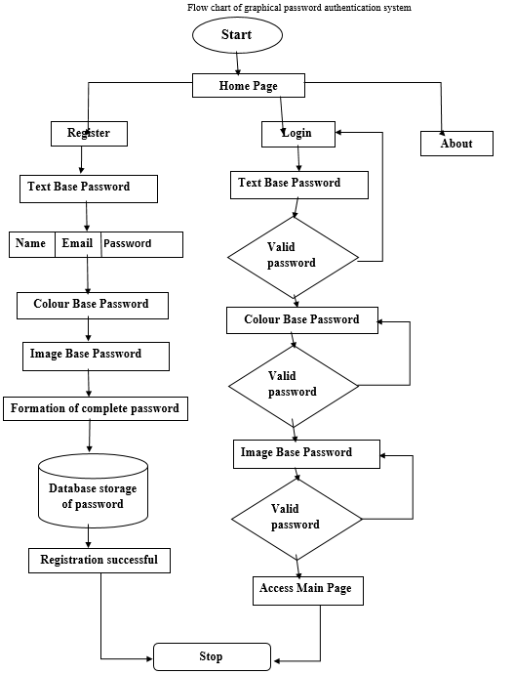
System Architecture

Slide 7
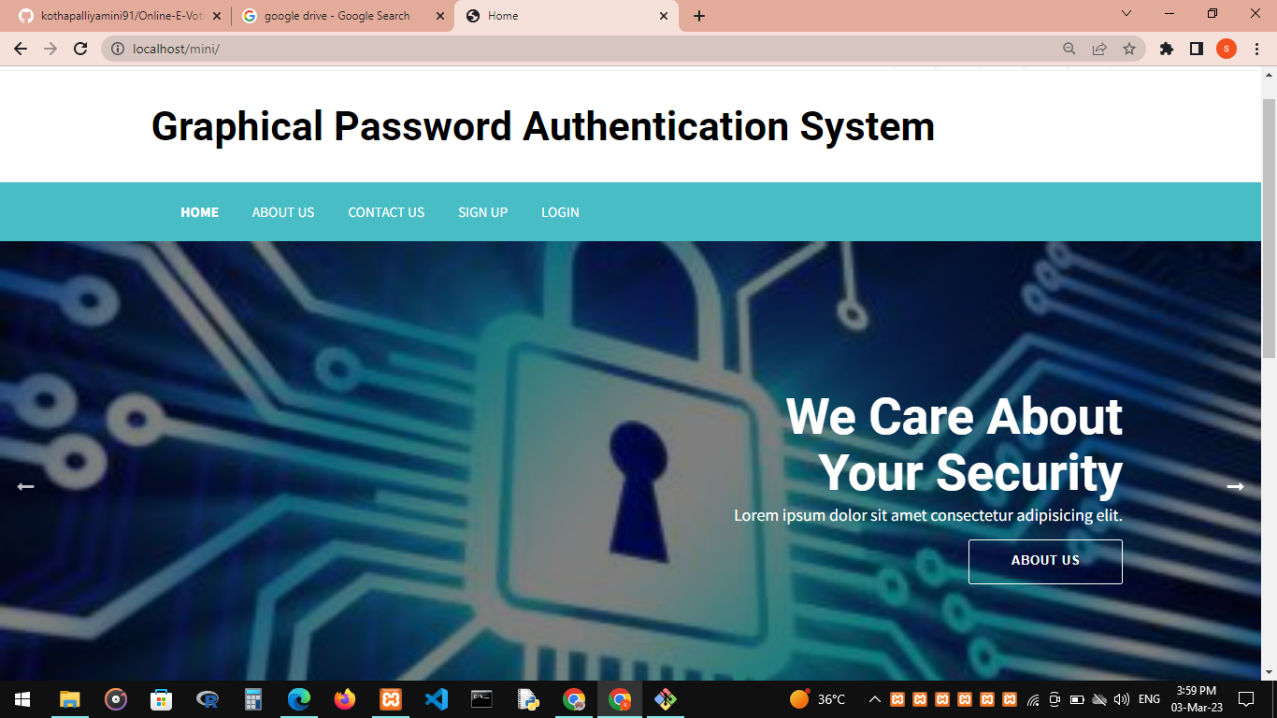
System Deployment Approach

Slide 8
System Requirements
Software Requirements
• Operating system Windows
• Domain: Full stack
• Backend: PHP
• Database: MY SQL (XAMPP server)
Hardware Requirements
System: 7 th Generation
INTEL.i5 Hard disk: 128 GB+
1TB HDD storage
• Ram: 4GB/8GB
• Operating system: 64-bit

Slide 9
Conclusion
A simple text-based shoulder surfing resistant graphical password, in which the user can easily and efficiently complete the login process without worrying about shoulder surfing attacks has been proposed. The operation of the proposed scheme is simple and easy to learn for users familiar with textual passwords. The user can easily and efficiently to login the system without using any physical keyboard or on-screen keyboard. Finally, the resistances of the proposed scheme to shoulder surfing and accidental login are analyzed and evidence of the usability and security by analyzing data collected from a large user study of Pass Points are provided.

Slide 10
Future Enhancement
In the future, hopefully this system can be applied in real life because it may help users that have secret or privacy account want to keep their account private and protect their data privacy. To make this more secure, the selection of every click points might be good if they have their own character or password

Slide 11
THANK YOU

